Slide 1
Data Preparation

Slide 2

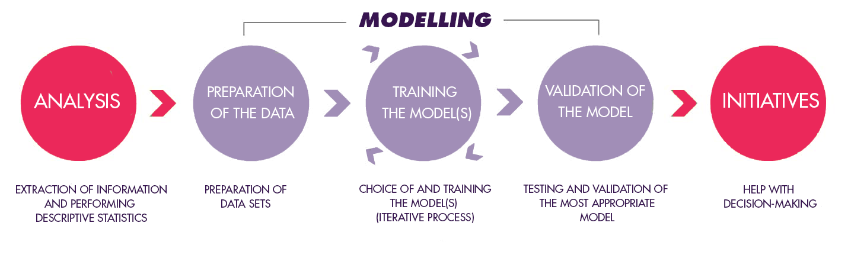
Data Science Process

Slide 3

Model Examples
Regression is the task for modeling continuous target variables.
Real Estate: Predicting house prices
Classification is the task for modeling categorical target variables.
Email: Predicting Spam/Not Spam
Notes:
Predictive Modeling: Process that uses data mining and probability to forecast outcomes.
Predictive Modeling Example: Weather forecasting and spam filters.

Slide 4
Motivation
Each observation must be labeled with a "correct answer.“
A predictive model relies on labeled data to learn the patterns between the features and the “correct answer
Notes:
Predictive Modeling: Process that uses data mining and probability to forecast outcomes.
Predictive Modeling Example: Weather forecasting and spam filters.

Slide 5
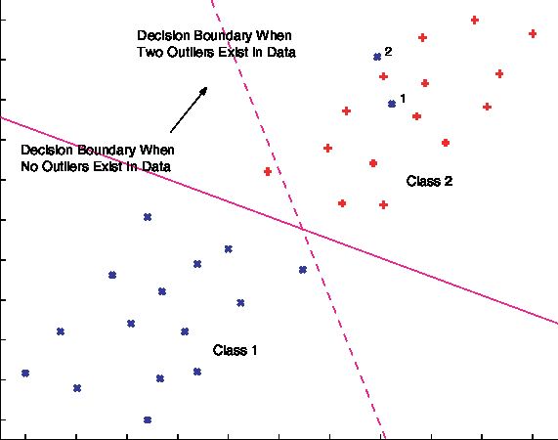
Outliers & Regression

Slide 6
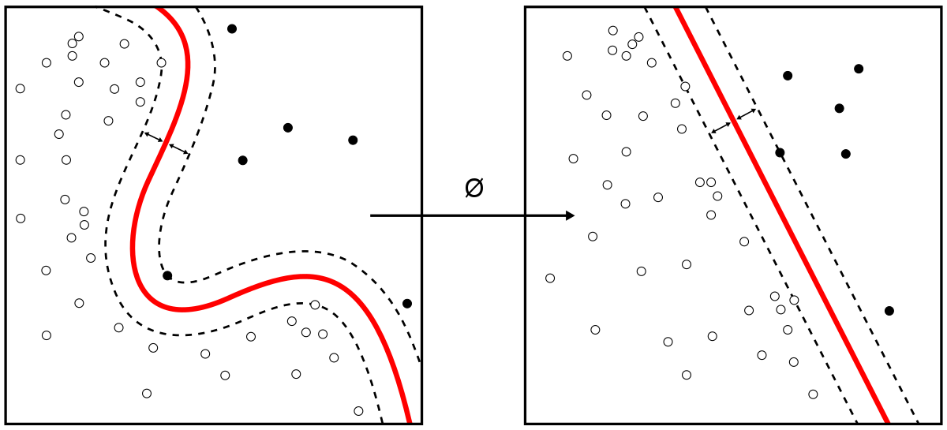
Outliers & Prediction

Slide 7

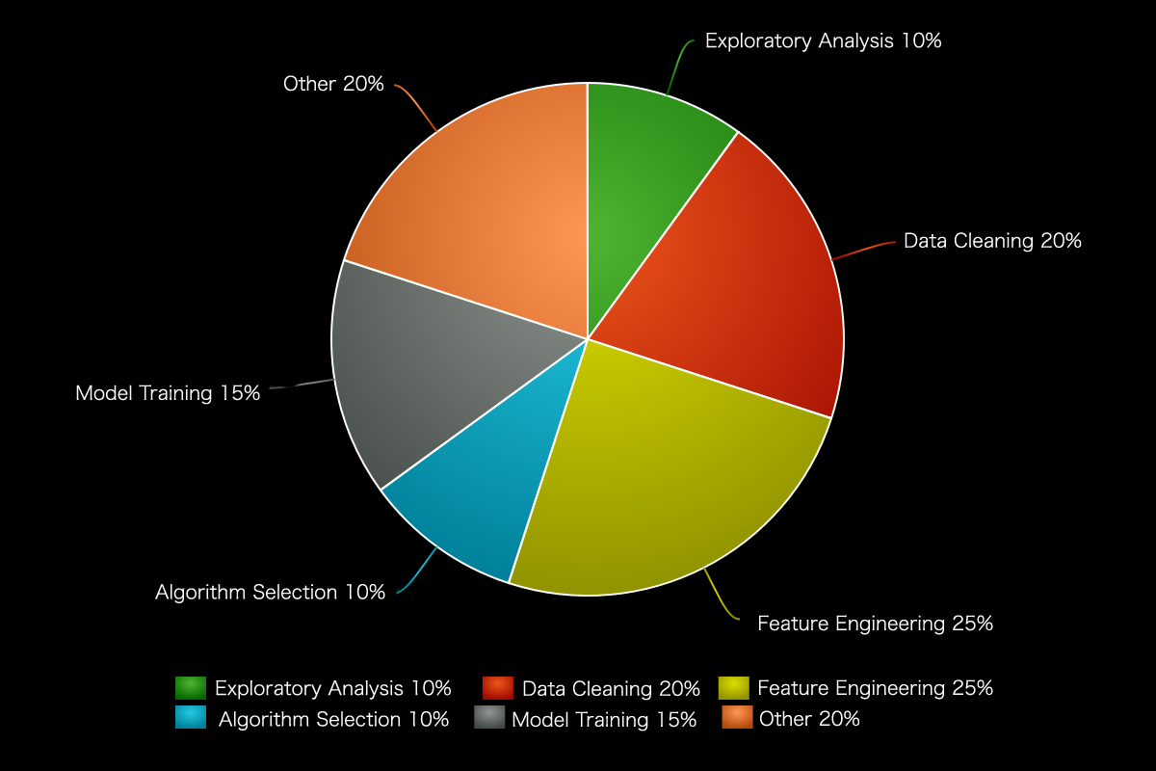
Data Preparation in Perspective
Notes:
Over half your time is spent working with the data (Exploratory Data Analysis, Cleaning and Feature Engineering)
Other 20%
Aggregating data, looking for sources (Api’s, Government, ect.)
Scraping/Parsing Data

Slide 8

Exploratory Data Analysis
Exploratory Data Analysis (EDA) is the first step in your data analysis process.
Here, you make sense of the data you have at your disposal and figure out which features of the data may be the best suited for the machine learning task at hand.

Slide 9
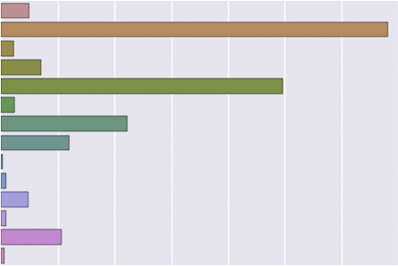
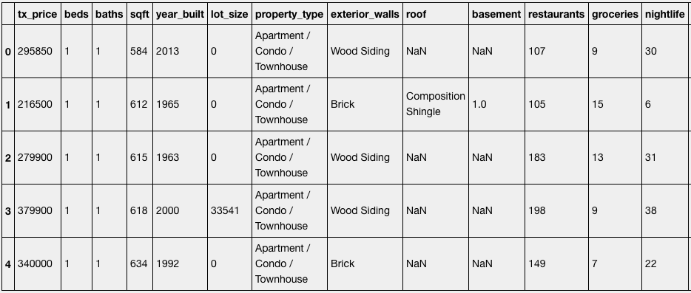
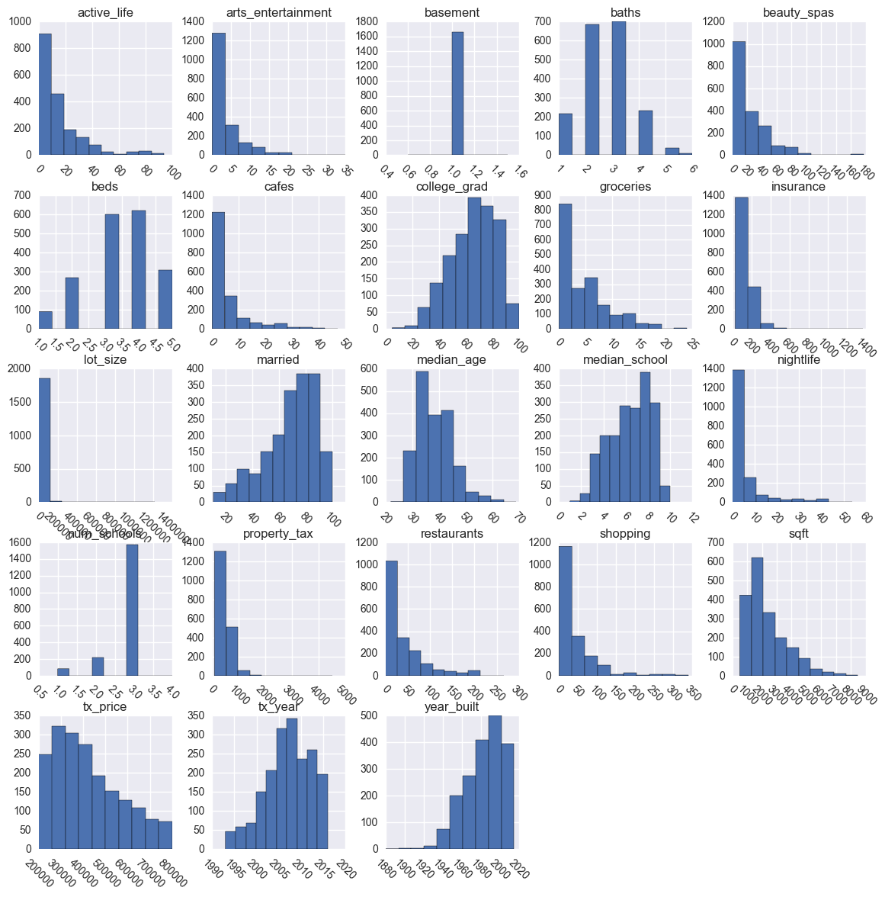

Exploratory Data Analysis - Topics Covered
Display example observations from the dataset with Pandas
Plot categorical distributions using bar plots
Plot Numerical Distributions
Study Correlations

Slide 10

Data Cleaning
The process of sanitizing data for further processing. This is a very common task and one that is rarely automatable.
Delete duplicate observations
Handle missing values
Combine sparse categorical features

Slide 11

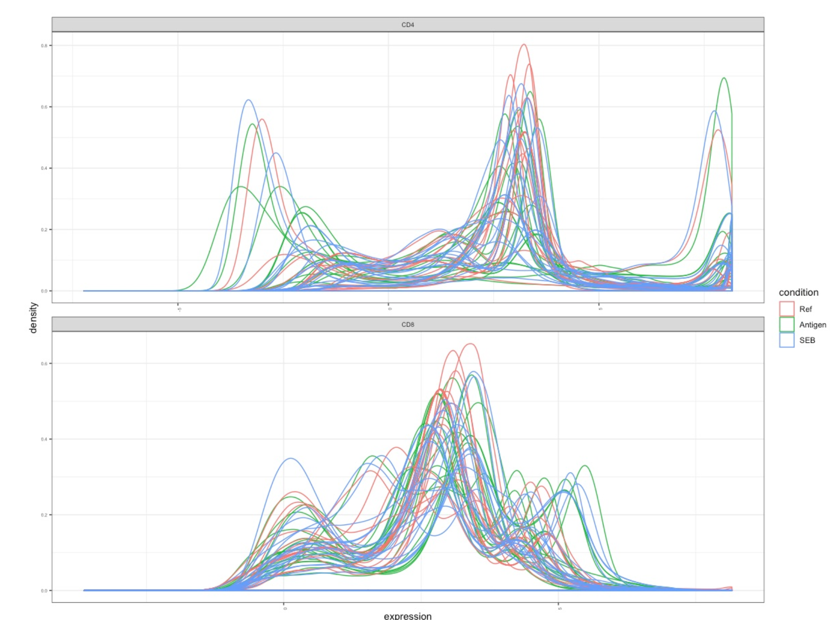
Original Data vs Processed Data
Unclean Data
Processed Data

Slide 12
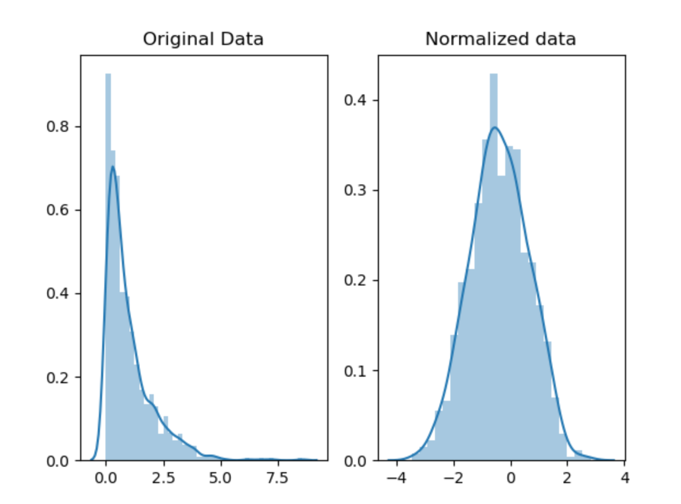
Original Data vs Processed Data

Slide 13
Feature Engineering
Feature engineering is about creating new input features from your existing ones.
This also includes converting features to a format which an algorithm can “understand.”
In general, you can think of data cleaning as a process of subtraction and feature engineering as a process of addition.

Slide 14
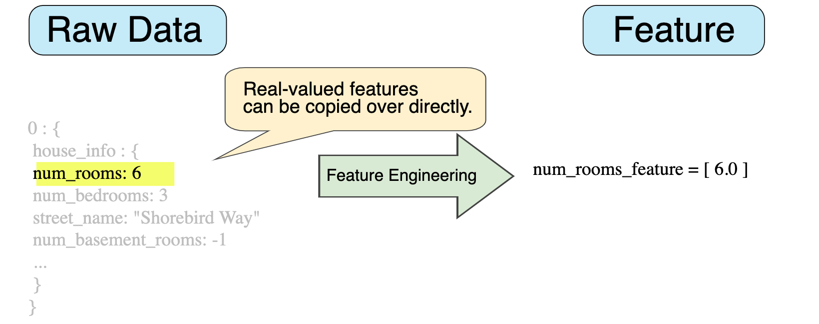
Feature Engineering

Slide 15
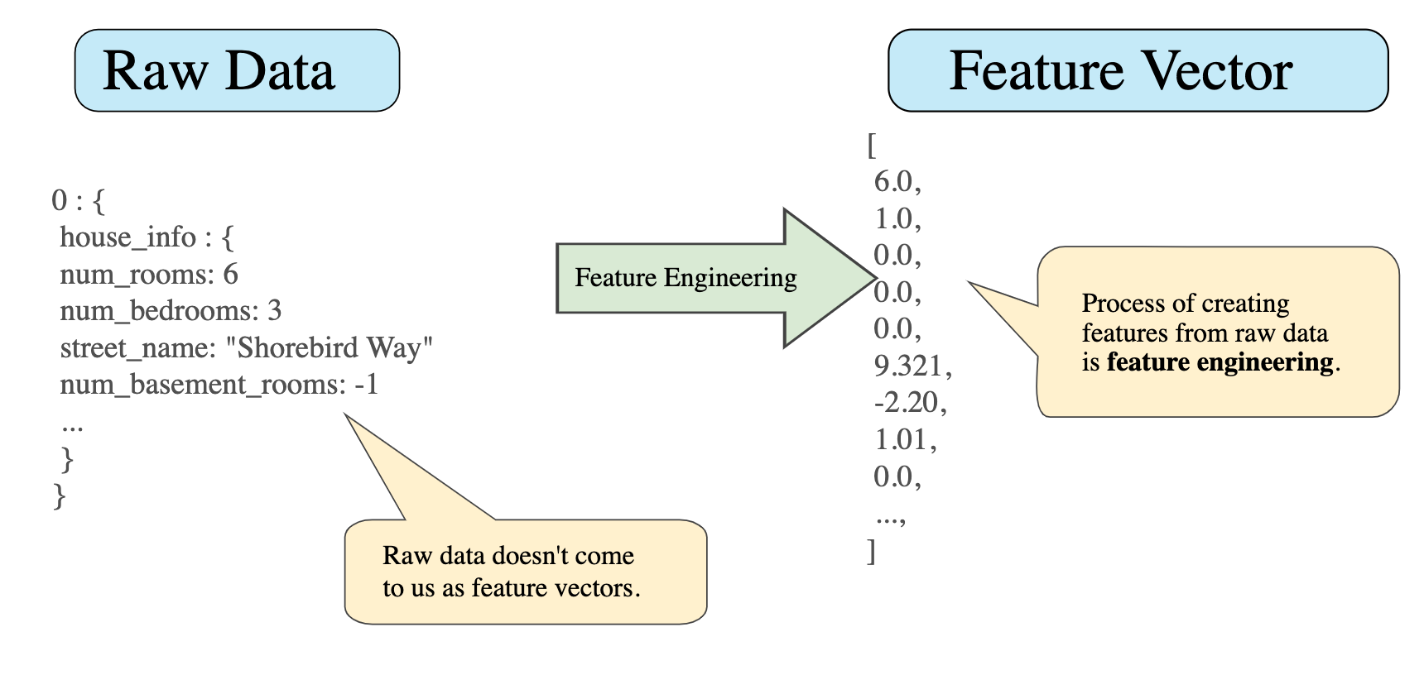
Feature Engineering

Slide 16
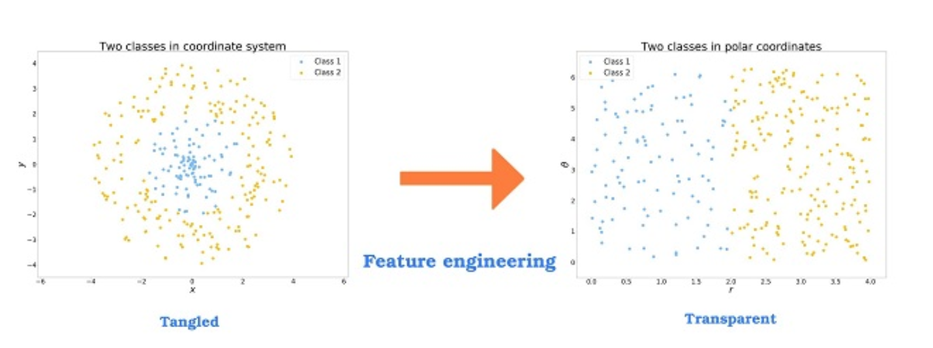
Feature Engineering

